Slide 1
TOWARDS Hybrid OpenStack Clouds in the Real World
Tim Bell
tim.bell@cern.ch
Toby Owen
toby.owen@rackspace.com

Slide 2
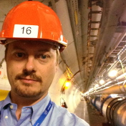
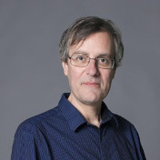
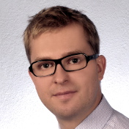
Meet the Players
Toby Owen
Tim Bell
Marek Denis
Head of Technical Strategy Rackspace
Lives in London, UK
toby.owen@rackspace.com
Head of Infrastructure Services, CERN
Lives in Geneva, Switzerland
tim.bell@cern.ch
Research Fellow
CERN
Lives in Geneva, Switzerland
marek.denis@cern.ch

Slide 3
Legal Disclaimers
This presentation outlines general information regarding our services and is for informational purposes only; all statements and information are provided “AS IS” and are presented without warranty of any kind, express or implied. Our product/services offerings are subject to change without notice.
Trademarks
Rackspace, Fanatical Support, and RackConnect are service marks of Rackspace US, Inc. registered in the United States and other countries. OpenStack is a trademark of OpenStack Foundation. Other trademarks and trade names appearing in this presentation are the property of their respective holders. We do not intend our use or display of other companies’ trade names, trademarks, or service marks to imply a relationship with, or endorsement or sponsorship of us by, these other companies.

Slide 4

CERN Introduction
Grids to Clouds
openlab
Use Case for Federation
Federation Details
What’s Next?

Slide 5


Slide 6
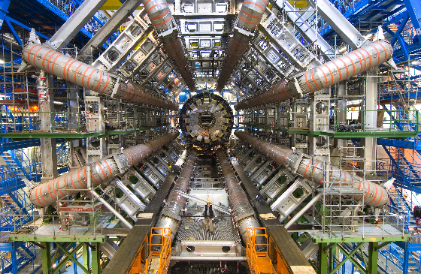

Slide 7
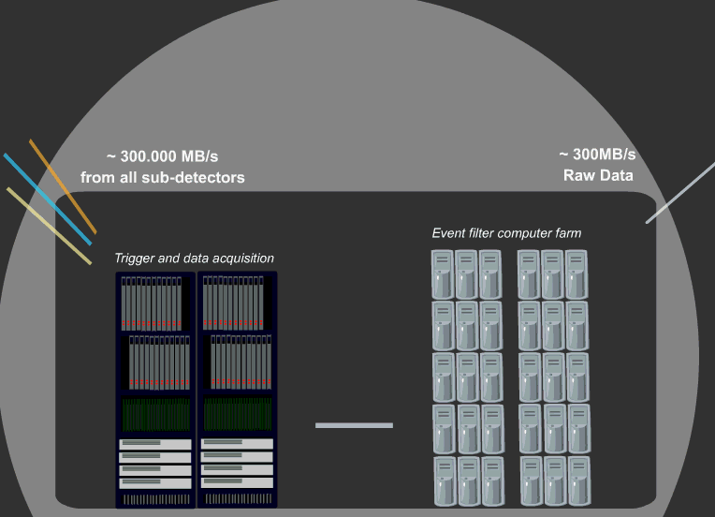
Trigger Farms to Filter Data
Around 1PB/s from the detectors
Filtered by farms of >1000 servers to 25Gb/s

Slide 8
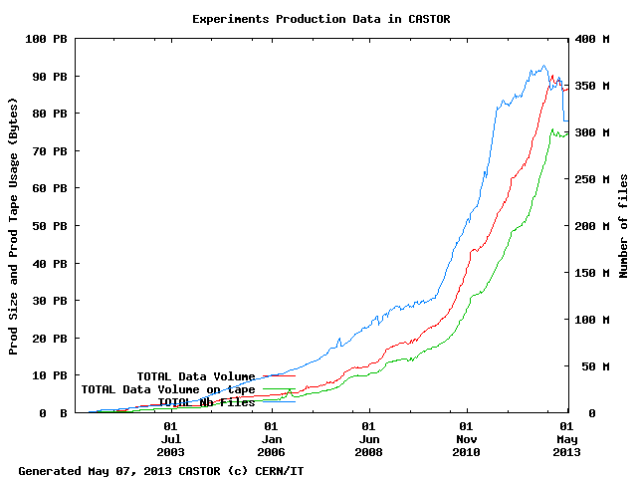

A Big Data Challenge
Notes:
These collisions produce data, lots of it. Over 100PB currently 45,000 tapes… data rates of up to 35 PB/year currently and expected to significantly increase in the next run in 2015. The data must be kept at least 20 years so we’re expecting exabytes….

Slide 9
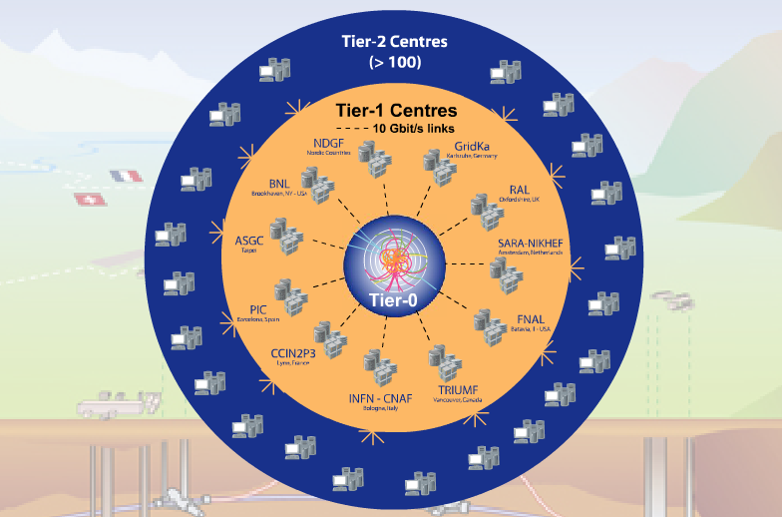
Tier-0 (CERN):
  Data recording
  Initial data reconstruction
  Data distribution
Tier-1 (11 centres):
Permanent storage
Re-processing
Analysis
Tier-2 (~200 centres):
Simulation
End-user analysis
Data is recorded at CERN and Tier-1s and analysed in the Worldwide LHC Computing Grid
In a normal day, the grid provides 100,000 CPU days executing over 2 million jobs
Notes:
The Worldwide LHC Computing grid is used to record and analyse this data. The grid currently runs over 2 million jobs/day, less than 10% of the work is done at CERN. There is an agreed set of protocols for running jobs, data distribution and accounting between all the sites which co-operate in order to support the physicists across the globe.

Slide 10
Grids and Clouds - Ian Bird (WLCG)
Grid: A distributed computing service
  Integrates distributed resources
  Global single-sign-on (use same credential everywhere)
  Enables (virtual) collaboration
Cloud: viewed as a large (remote) data centre
  Economy of scale – centralize resources in large centres
  Virtualisation – enables dynamic provisioning of resources
Technologies are not exclusive
  In the future our collaborative grid sites will use cloud technologies (virtualisation etc.)
  We will also use other cloud resources to supplement our own

Slide 11
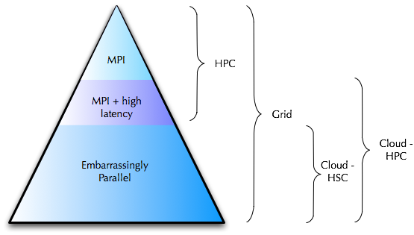
HPC, HSC, Grids, Clouds : Cloudscaling
High Performance Computing
  Single program
  e.g. CERN Engineering
High Scalability Computing
  Throughput focus
  Can be distributed
  e.g. Physics Simulation
http://www.cloudscaling.com/blog/cloud-computing/grid-cloud-hpc-whats-the-diff/

Slide 12
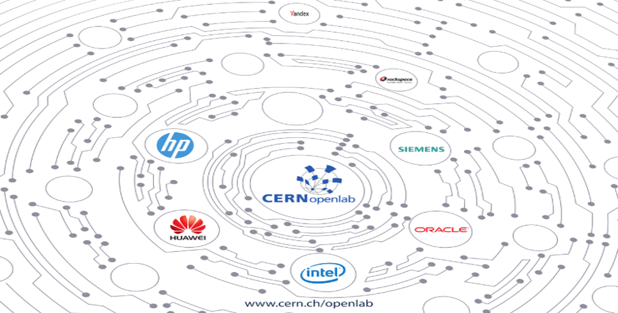
CERN openlab in a nutshell
A science – industry partnership to drive R&D and innovation with over a decade of success
Evaluate state-of-the-art technologies in a challenging environment and improve them
Test in a research environment today what will be used in many business sectors tomorrow
Train next generation of engineers/employees
Disseminate results and outreach to new audiences

Slide 13
Virtuous Cycle
CERN needs push the limit
Apply new techniques and technologies
Joint develop in rapid cycles
Test prototypes at CERN
Produce advanced products and services
A public-private partnership between the research community and industry

Slide 14
Tests in Rackspace Public Cloud
Ran 6,288 virtual machines through the Rackspace public cloud, 6 hours for each
Simulation workloads
  High CPU
  Low Disk I/O
  Very low network I/O

Slide 15


Cloud Resources are Isolated
Many Others on Their Way
Public Cloud such as Rackspace
NecTAR
Australia
Brookhaven National Labs
IN2P3
Lyon
CERN Private Cloud
22K cores
ATLAS Trigger
28K cores
CMS Trigger
12K cores
Notes:
The trigger farms are those servers nearest the accelerator which are not needed while the accelerator is shut down till 2015
Public clouds are interesting for burst load (such as coming up to a conference) or when price drops such as spot market
Private clouds allow universities and other research labs to collaborate in processing the LHC data

Slide 16
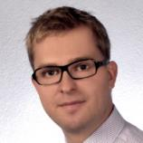
CERN/Rackspace Openlab project
Kicked off 1 October 2013
Full time developer working within OpenStack community on this project
Project success = Demonstration of federated identity and aggregated services between a Rackspace Private Cloud at CERN and at least one other cloud.

Slide 17
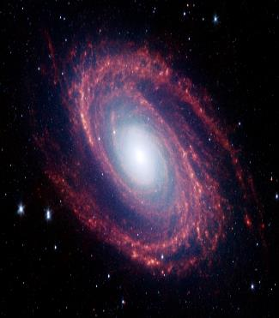
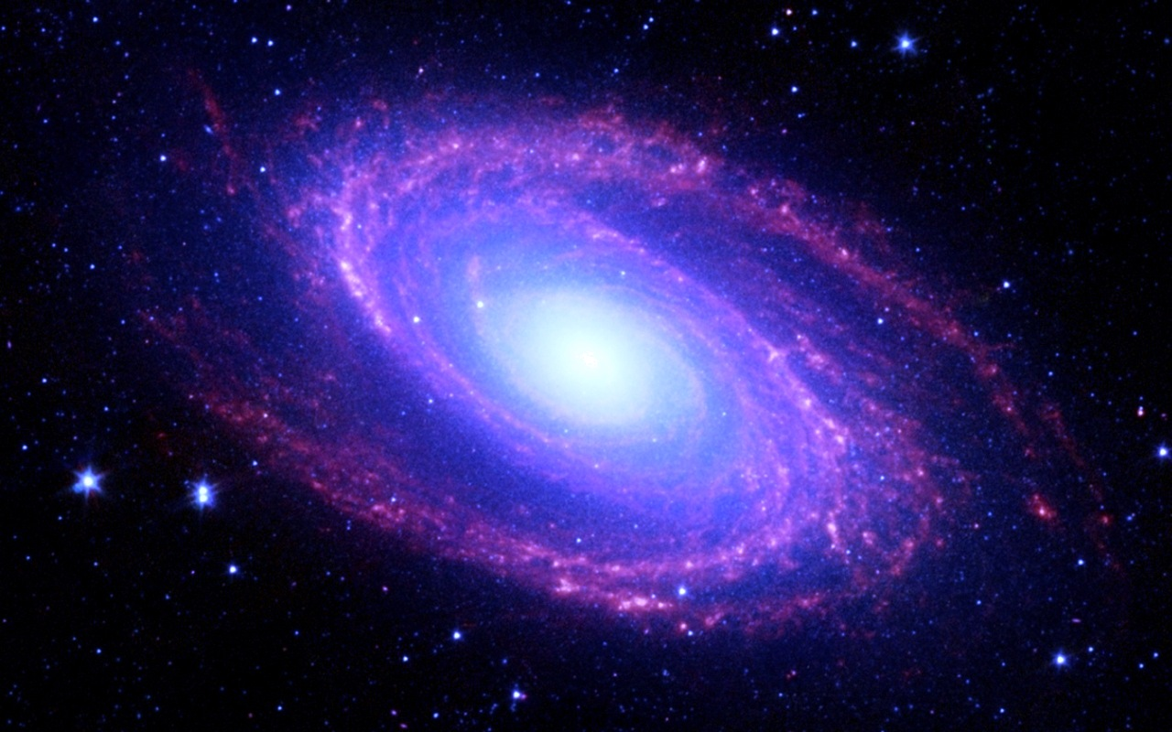
Openlab Use Cases
Rackspace Public Cloud
Rackspace Private Cloud @ CERN
CERN Private Cloud

Slide 18
Goals for a year of joint research
A reference architecture for federation of OpenStack clouds
Blueprints and code contributions to the open source communities
Presentations and white papers to allow others to build on our findings

Slide 19
How?
Deploy a Rackspace private cloud at CERN in parallel with the CERN Private cloud
Investigate OpenStack cloud federation in areas such as Authentication, Images, Networking and Metering
  Architecture
  Blueprints
  Code and Configuration
Demonstrate burst workload from private clouds to Rackspace public cloud

Slide 20
Why Now?
    Hybrid has been largely limited to single site, or multiple sites with little integration
    Use cases are all “future” for multiple site hybrid distributed apps
    CERN’s scale is ready to push this boundary into multiple sites/multiple clouds, ideal use case and environment to spur innovation and development of capabilities required to meet this goal

Slide 21
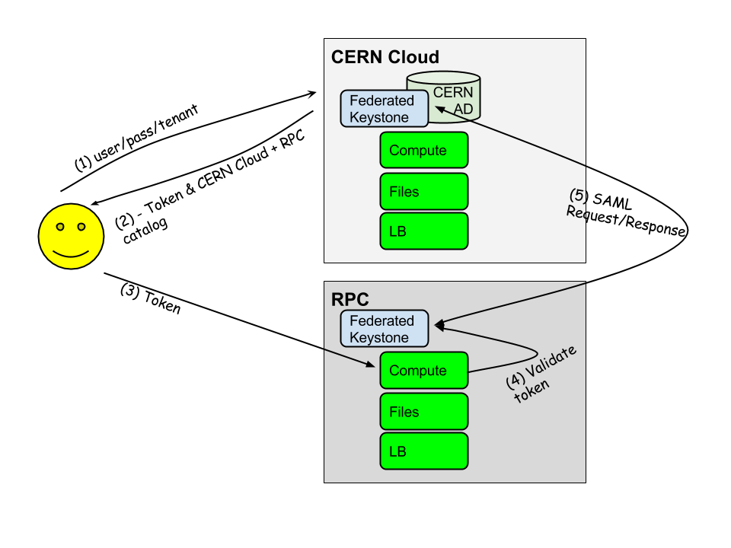
FEDERATION: priorities
IDENTITY – how we defined it:
  As a user I want to use my single set of existing credentials to access services across multiple clouds.
Notes:
A good way to think about this is like a google or facebook account. I can use a single login, or identity, to access many services.
It creates a cloud of clouds.
THIS WORK IS BEING DONE IN THE KEYSTONE PROJECT

Slide 22
FEDERATION: priorities (cont.)
AGGREGATED SERVICES – how we defined it:
    SERVICE CATALOG:
      As a user, when I authenticate using one set of credentials, I’d like to retrieve a full set of services across clouds that I can access with my token.
    IMAGE MANAGEMENT/PORTABILITY:
    As a user, I want to be able to update a compute image one time in one place and make that available to build VM’s in other clouds from that image.
Notes:
Service catalog work is being done in Keystone
Image Management work is being done within Glance

Slide 23
FEDERATION: priorities (cont.)
Future areas of work:
  Compute service enhancements
  Usage
  Rules/policy/business logic engine to support smart, automated workload management
Notes:
S

Slide 24
FEDERATION: progress
  Infrastructure:
      Built 20 node Rackspace Private Cloud on premise at CERN for testing
  Identity:
      Collaboration with Steve Martinelli (IBM), David Chadwick (Kent) and Adam Young (RedHat)
      Alignment around requirements and path forward (5th or 6th iteration of markdown)

Slide 25
FEDERATION: progress
  Identity (continued):
      Outlined dev work
      Starting development work
      2 initial use cases:
        After I authenticate against my local CERN Keystone and receive a token, I can use it and play on Rackspace Private Cloud (Rackspace-Keystone will communicate with CERN-Keystone and make sure the token is valid, it's mine and so on).
        Despite having an account at CERN, I may want to explicitly authenticate against Rackspace Private Cloud Keystone, claiming that it's trusted CERN Identity Provider who can authenticate me.

Slide 26
FEDERATION: next steps
  Identity:
      Continue development against first 2 stories
  Service Catalog and Images:
      Begin discussions and determine next steps

Slide 27
FEDERATION: some thoughts
    Good early traction: after 4 weeks, already have made meaningful progress
    The right timing: Keystone v3 and previous oAuth work provide a great foundation

Slide 28

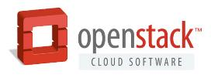
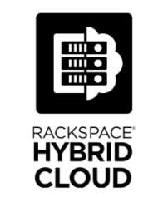


Why do we care?
It’s our strategy
OPEN TECHNOLOGIES
HYBRID CLOUD
FANATICAL SUPPORT®
DEDICATED
PUBLIC
PRIVATE
Cofounded OpenStack to power the Hybrid Cloud and to provide flexibility to run apps anywhere
Best-fit architecture
for your application
and business needs for today and the future
Trusted, committed experts to help architect
and run your application hosting platform

Slide 29


Industry Experts Agree
“Hybrid IT is the new IT and it is here to stay….Hybrid IT creates symmetry between internal and external IT services that will force an IT and business paradigm shift for years to come.“
- Chris Howard, Managing VP
"Hybrid is the end-state. A lot of people say ‘the end state is cloud’ I don’t buy that at all… It is about creating the right architecture to support the application and the evolution of the application over time.”
- James Staten, VP & Principal Analyst
Gartner Source: http://www.gartner.com/newsroom/id/1940715
Forrester Source:http://www.rackspace.com/blog/why-hybrid-cloud-is-a-must-have-for-the-enterprise/
Notes:
Cloud is great but is not the future for ALL apps
Don’t start with the technology as the answer – understand requirements and then find the right technology
Consider how apps will evolve over time and their future needs
No one imagined the cloud would be this transformational 5 years ago, it is wise to assume technology will keep changing at the same (or faster pace) in the next 5 years, therefore, a hybrid platform is more likely to serve the future needs of the business

Slide 30
What can you do?
Get involved in the discussion
  Happening around Keystone at the moment
  More will follow with Glance
Attend the design meetings this week for Keystone and Glance

Slide 31

Questions ?

Slide 32


RACKSPACE® HOSTING | 9/F, Cambridge House, Taikoo Place, 979 King’s Road | Quarry Bay, Hong Kong
Sales: +852 3752 6465 | Support +852 3752 6464 | www.rackspace.com.hk
RACKSPACE® HOSTING | © RACKSPACE US, INC. | RACKSPACE® AND FANATICAL SUPPORT® ARE SERVICE MARKS OF RACKSPACE US, INC. REGISTERED IN THE UNITED STATES AND OTHER COUNTRIES.

Slide 33
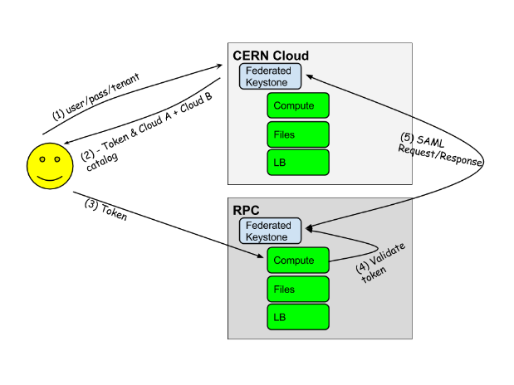
Federation: Cloud to cloud identity federation with minimal client changes

Slide 34
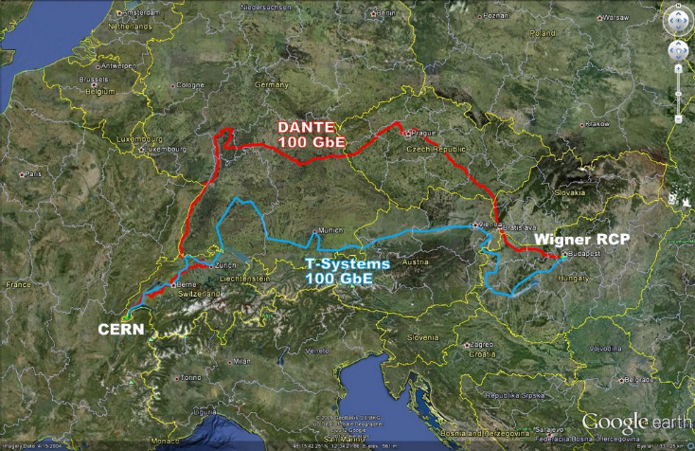

Slide 35
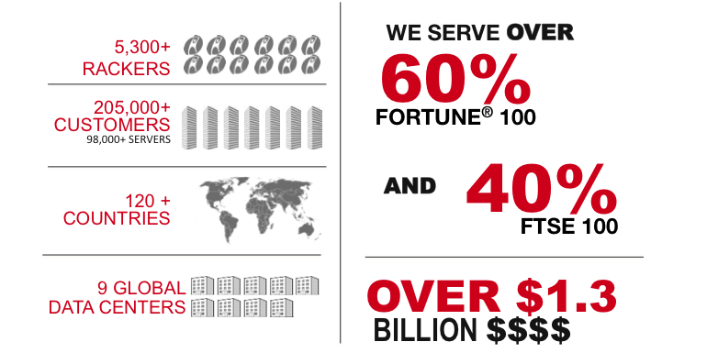
Who is Rackspace?

Slide 36
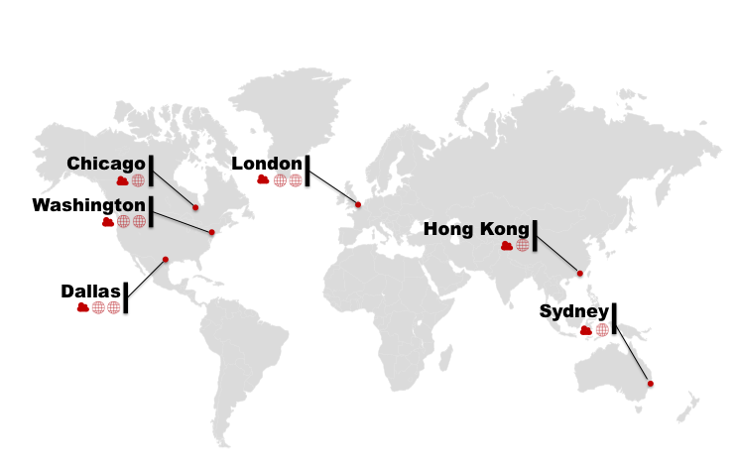
Where is Rackspace?

Slide 37
Rackspace and OpenStack by the Numbers
CI/CD
API VOLUME
2,800+
1.081B
PRODUCT UPDATES
SINCE LAUNCH
API CALLS ON CLOUD SERVERS
SINCE LAUNCH
PRIVATE CLOUD
MARKET SHARE
32,200+
70%
DOWNLOADS
SINCE AUGUST 2012
OF 2013 OPENSTACK MARKET
(451 GROUP)

